Slide 1

CLASS 10: JavaScript Basics

Slide 2
Introduction: Bringing Websites to Life
What is JavaScript?
- JavaScript is a programming language that adds interactivity, dynamic behavior, and logic to web pages.
- While HTML defines the structure and CSS defines the presentation, JavaScript defines the behavior.
Analogy:
- HTML = The skeleton and organs of a body (structure)
- CSS = The skin, clothes, and appearance (presentation)
- JavaScript = The brain and muscles that make everything work (behavior)

Slide 3
Intoduction cont’d
What Can JavaScript Do?
Manipulate HTML content
Respond to user actions (clicks, form submissions, etc.)
Create animations and dynamic effects
Validate form data
Fetch data from servers (APIs)

Slide 4
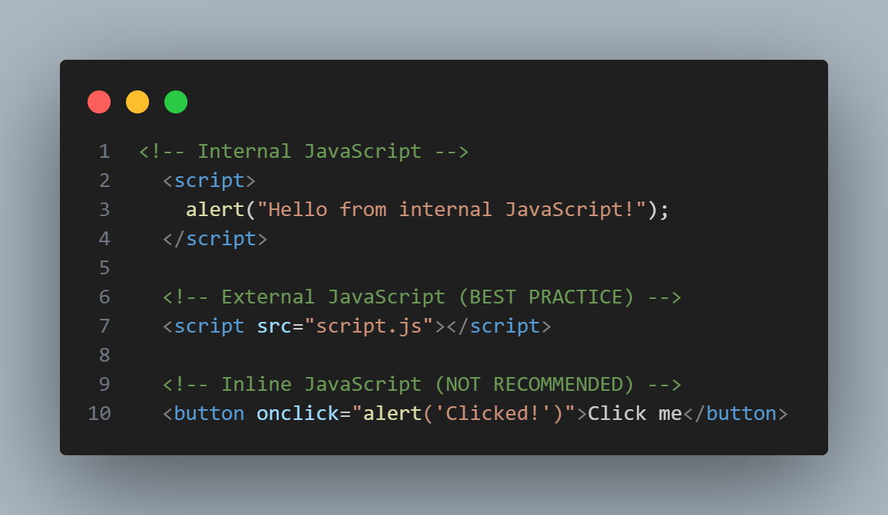
Part 1: Including JavaScript in HTML
Three Ways to Add JavaScript
Internal JavaScript: Using <script> tags in HTML
External JavaScript: Linking to a separate .js file (Recommended)
Inline JavaScript: Directly in HTML attributes (Avoid for complex code)

Slide 5
Part 2: Variables – Storing Data
Declaring Variables
-Variables are containers for storing data values. JavaScript has three ways to declare variables:
Keyword | Scope | Can Be Reassigned ? | Can be Redeclared? | Use Case
var | Function scope | Yes | Yes | Avoid - outdated
let | Block scope | Yes | No | Use for values that change
const | Block scope | No | No | Use for values that don't change

Slide 6
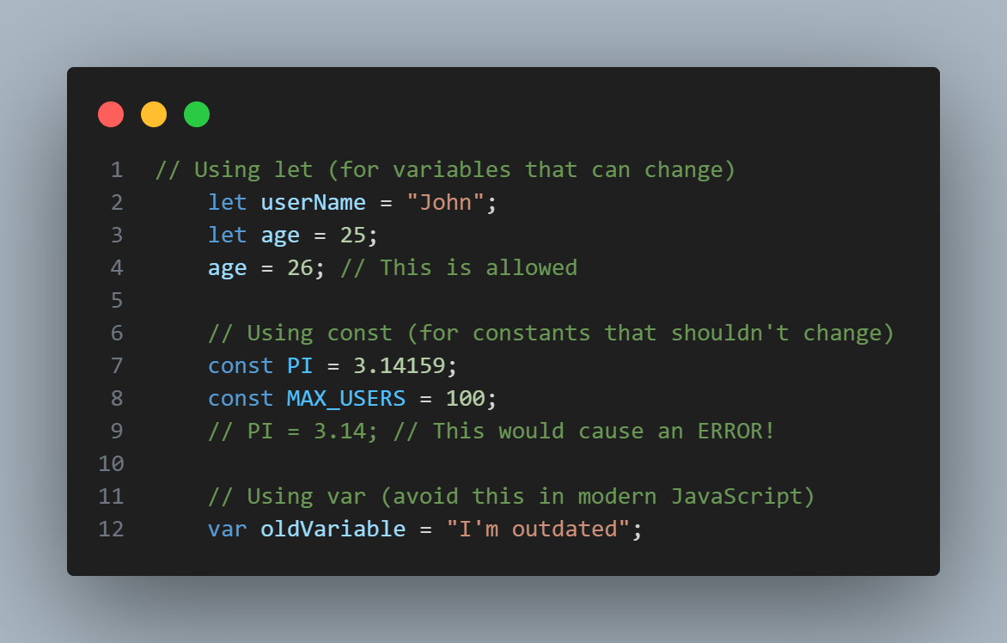
Examples

Slide 7
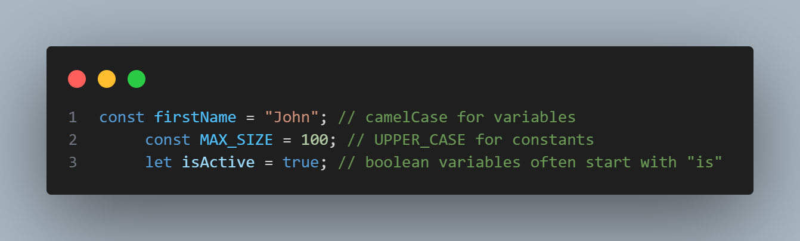
Variables cont’d
Variable Naming Rules
- Can contain letters, digits, underscores, and dollar signs
Must begin with a letter, $, or _
Are case sensitive (myVar ≠ myvar)
Cannot user reserved words(let, const, if, function, etc.)

Slide 8
Part 3: Data Types
Primitive Data Types
JavaScript has 7 primitive (basic) data types:
Type | Description | Example
Number | Integer or floating-point numbers | 42, 3.14, -5
String | Text data | “Hello”, ‘World’, `Template`
Boolean | Logical true/false | true, false
Undefined | Variable declared but not assigned | let x; (x is undefined)
Null | Intentional empty value | let y = null
Symbol | Unique identifier | Symbol(‘id’)
BigInt | Very large integers | 12345678901234567890n

Slide 9
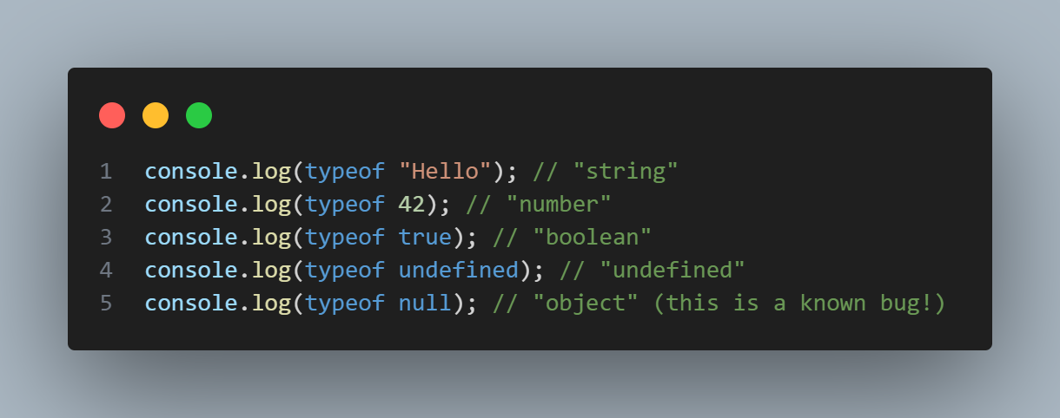
Examples

Slide 10
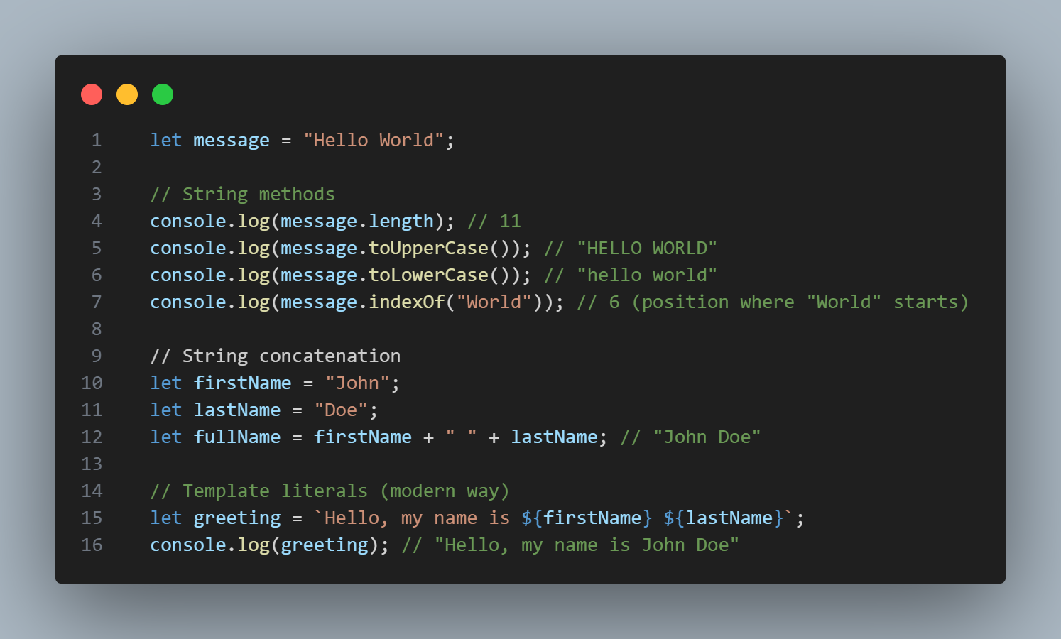
Working with Strings

Slide 11
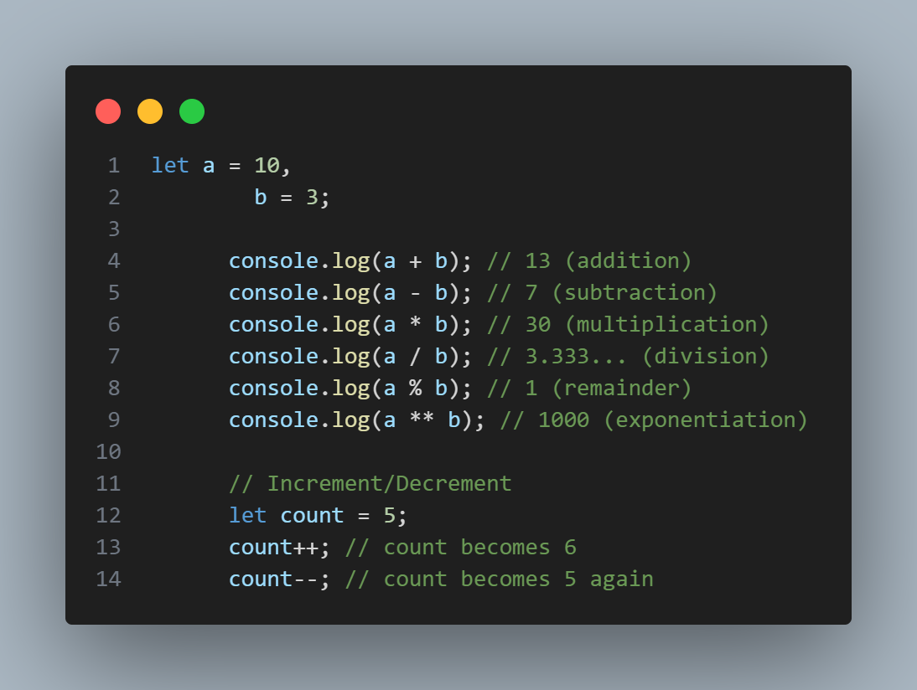
Operators

Slide 12
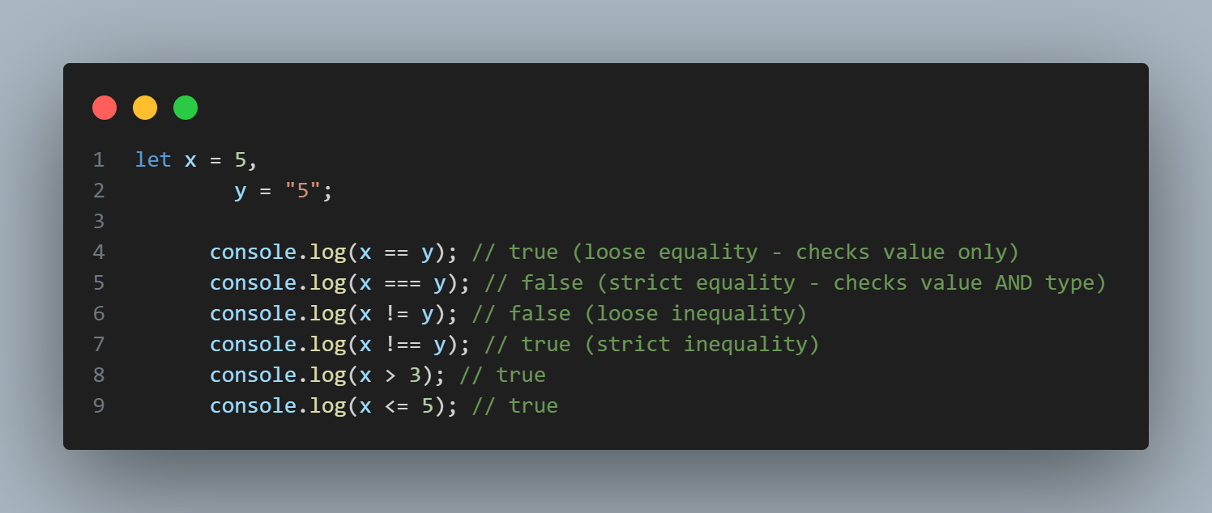
Comparison Operators

Slide 13
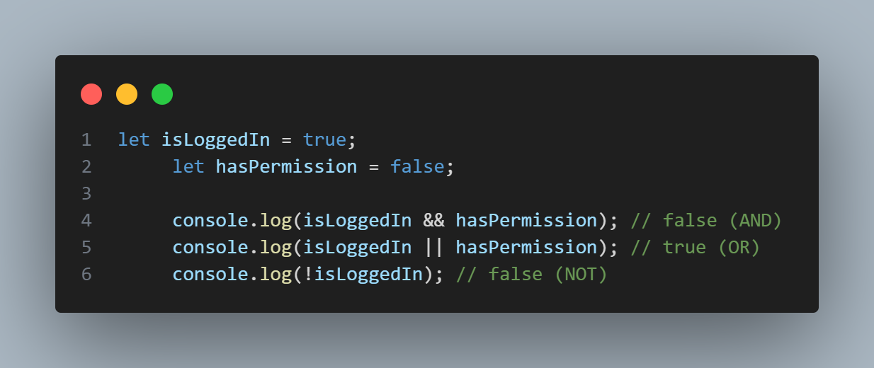
Logical Operators

